Slide 1





READING WORKSHOP
Mrs Orchard

Slide 2
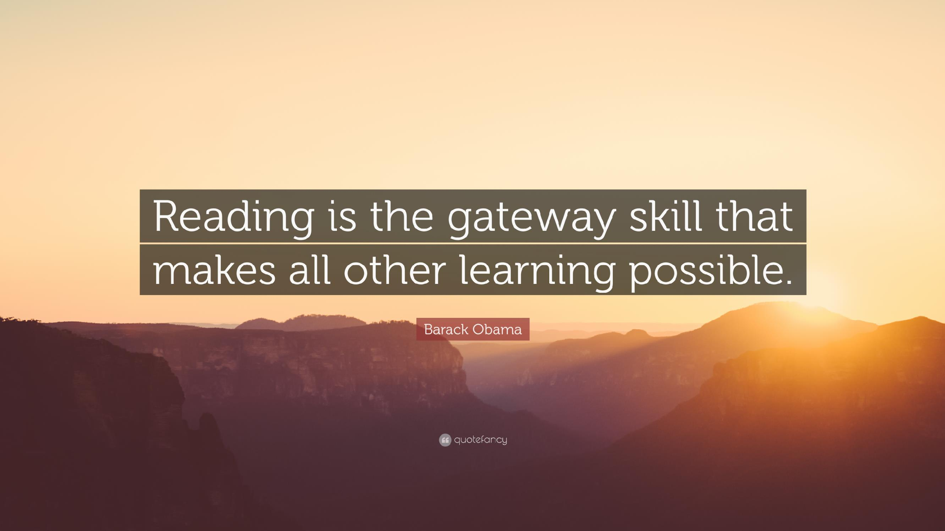



Slide 3

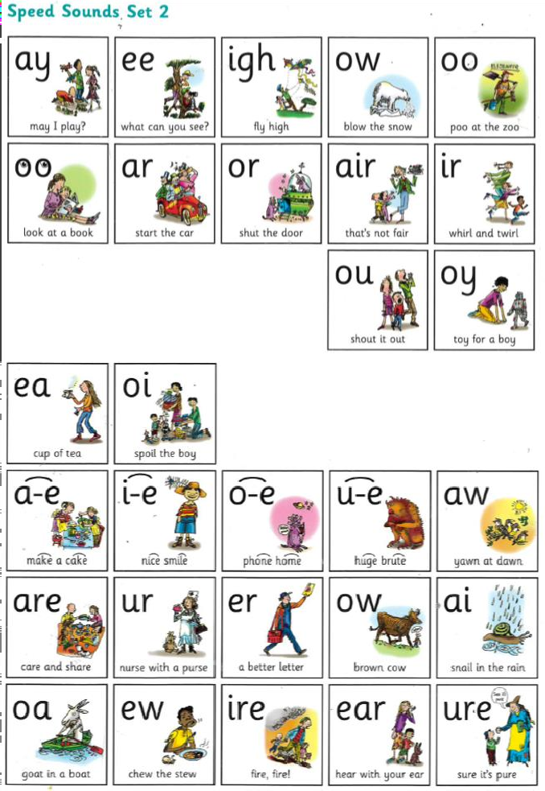
READ WRITE INC.
Read Write Inc is a phonics programme that we use at Waterside to teach your child to read. It begins in Reception and carries through into Year 2 or when the child is fluent with their sounds and reading.
Children are progressively taught to read and spell new sounds
until they develop accuracy and fluency.
Words in the story books that we use only contain the sounds
that the children have been taught previously.
Children then practice these books at home to show off how fluently and confidently they can read!

Slide 4
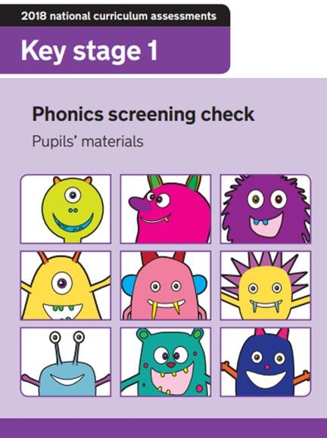
YEAR 1 PHONICS SCREENING CHECK
All Year 1 children sit the screening check in June each year.
Children are given 40 words to decode and read.
These 40 words include real and ‘alien’ words.
Children must identify the sounds in the word and blend them together accurately.
In previous years, the pass mark has been 32/40

Slide 5
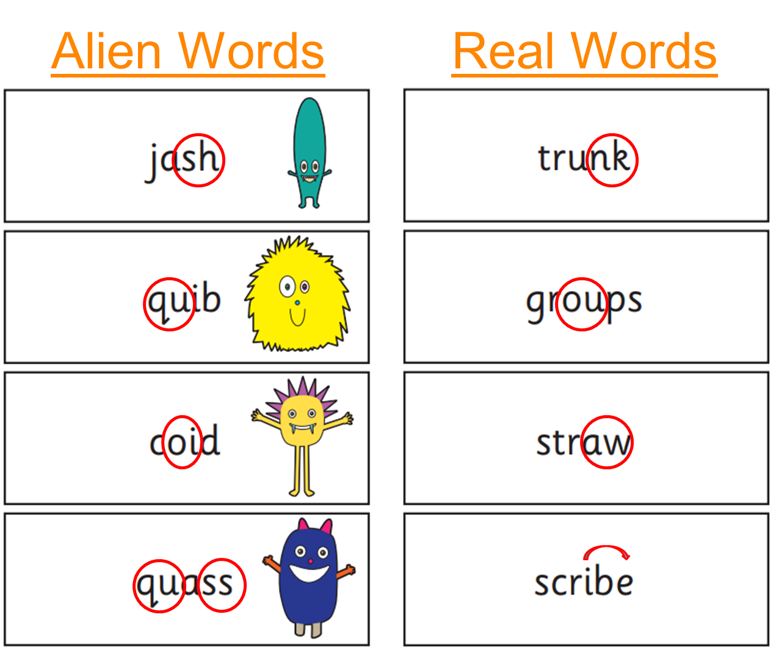
YEAR 1 PHONICS SCREENING CHECK EXAMPLE

Slide 6
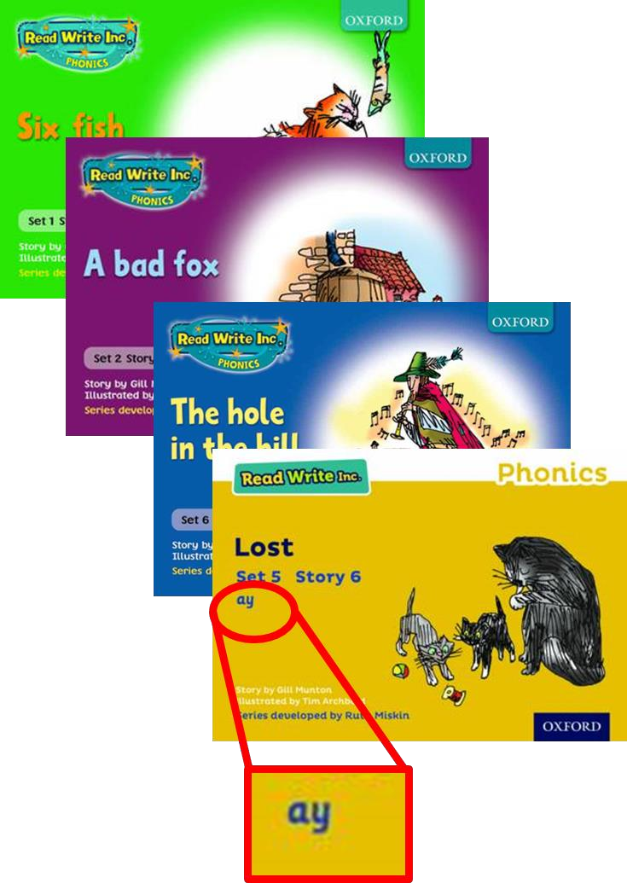
HOW READ WRITE INC. HELPS CHILDREN TO PASS THE PHONICS SCREENING CHECK
Read Write Inc. tailors to your child’s reading ability.
Children are grouped according to their ability to allow them to make accelerated progress in reading.
Each book teaches the children to read a specific sound, including all the sounds taught previously.
Children should be able to read these books independently as they are studied in school during the week.
These books are the biggest focus in Reception, Year 1 and 2 as they consolidate the phonics they have been taught in school and ensures they make good progress.

Slide 7

READING IN KS2
Children from Year 3 up to Year 6 continue to have reading at the centre of all their learning. Now that they can decode accurately and fluently, they build on from these strong foundation skills.
Children read independently, as a class and in all of their other foundation subjects (such as Geography, History, RE and Science).
Children have the opportunity for individual quiet reading every day, reading as a whole class, and being heard read by an adult in school should they require the additional support.
Reading volunteers (In KS1 and KS2)

Slide 8


What is Accelerated Reader?
Accelerated Reader is a computer based reading scheme that helps to monitor and progress children with their reading.
It helps to identify children’s strengths and areas for improvement.
Provides details of a child’s reading level and the most appropriate book level (ZPD) to enable progress in reading.
Accelerated Reader is for KS2 children. There will be a cross over into the scheme some point from Year 2 onwards. Children are assessed every half term.

Slide 9
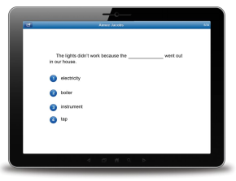
Star Reading
20 minute computer-adaptive test used to assess reading ability.
Tracks reading growth
Provides children with a personalised reading age called the ZPD (Zone of Proximal Development).
Tests a wide range of reading skills that progressively get more advanced with each correct answer given.
Completed each half-term to track progress and provide new reading levels.

Slide 10
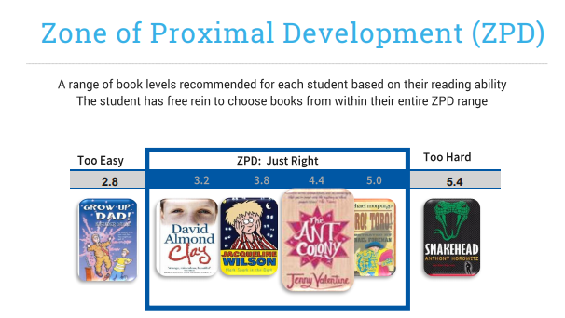

Slide 11
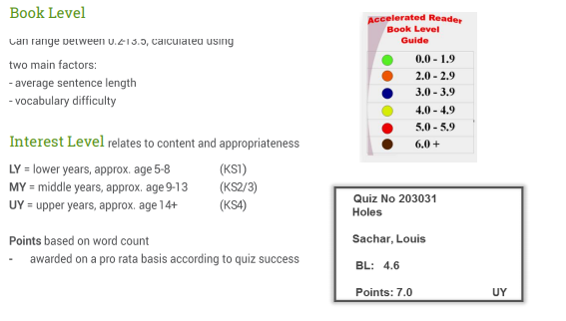
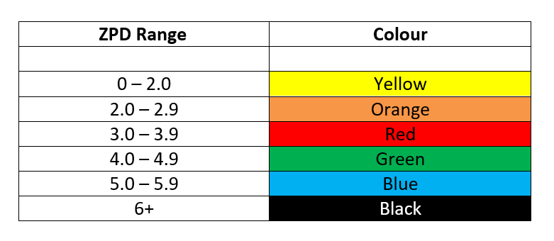

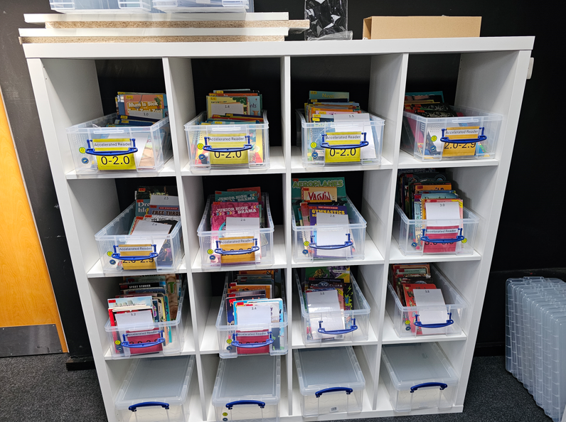

Slide 12
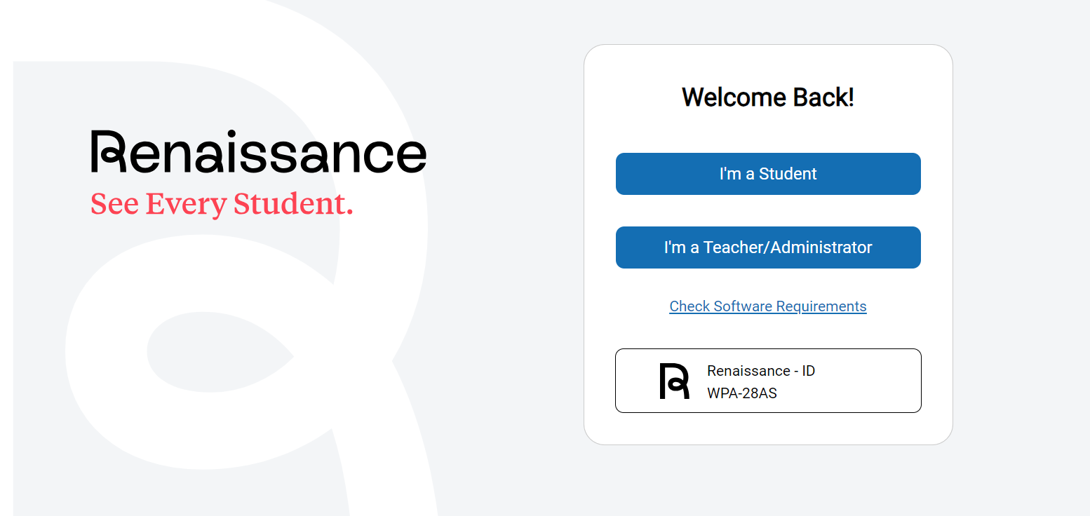
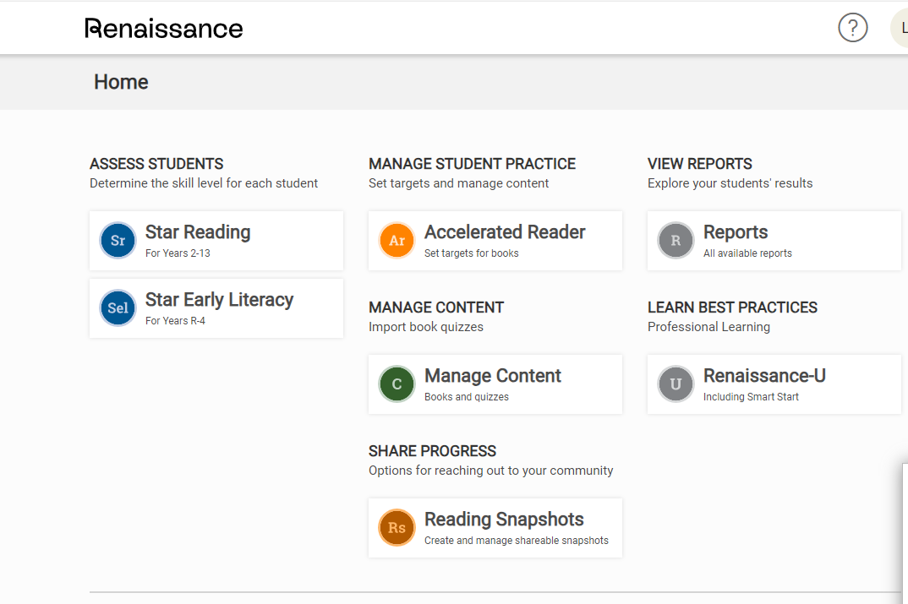
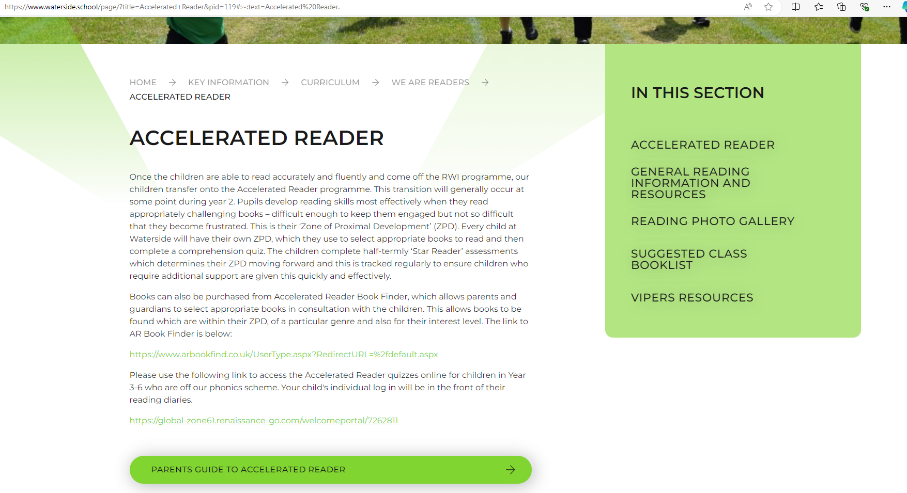
Accelerated Reader Book Quizes
After reading a book, children will then take a quiz online based on that book they have just read. These will be completed at school.
This is normally around 10 questions.
It will test that the child has FULLY understood the book, being able to have a deeper understanding of the text.
Instant results for the child with then recommended books to choose next.
Children will read and quiz on as many books as possible until the next Star Reader test.

Slide 13
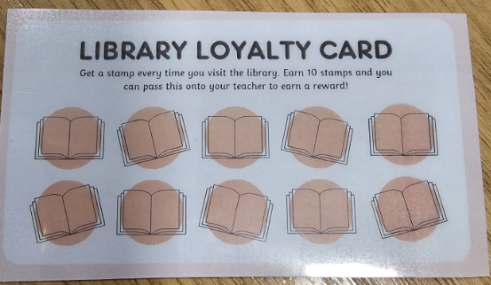
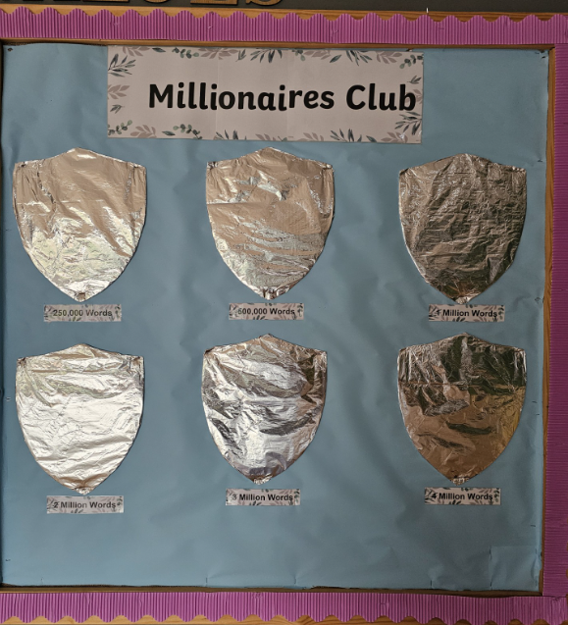
Incentives and rewards
We will be encouraging children to read with their own
‘Reading Card’. Children who achieve 60% or more on their book quiz will be able to get a stamp on their card which leads to some very exciting incentives!
This is to encourage deep understanding of the books and not just children rushing through a book without taking their time to fully understand the text they are reading.
25000 words to become a bronze millionaire
1 million- silver
4 million- gold

Slide 14
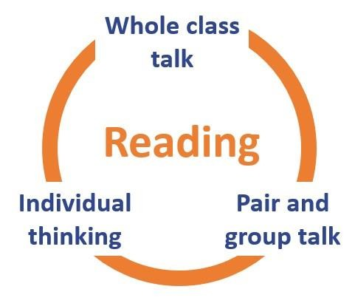
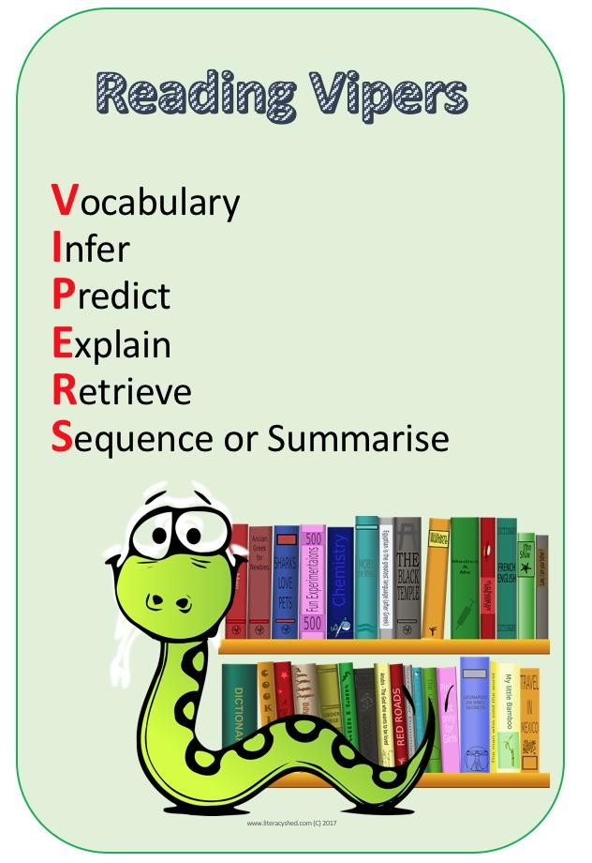
VIPERS and Comprehension
Once children can decode words accurately and increase their fluency, comprehension is the next skill important to understanding what it is they are reading.
This requires the child to actively think and wonder about what it is that they have just read and retain the information in their short-term memory.
Children use the 'VIPERS' framework to help break down the individual skills required to read and comprehend a text fully.
These skills are taught individually and build up over time throughout Key Stage 1 and 2, until children can read and comprehend fully and independently.

Slide 15


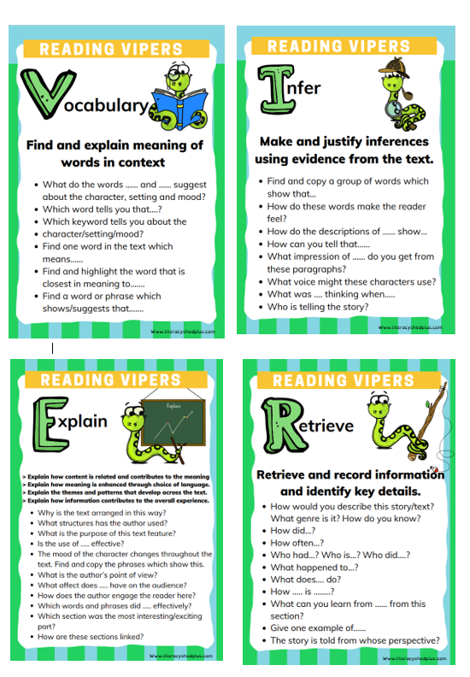
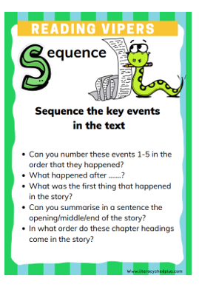
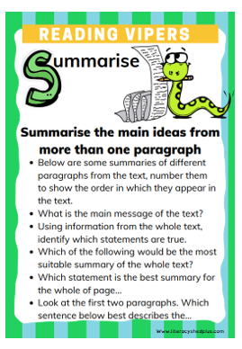
PARENT COMPREHENSION QUESTIONS
These questions cover the six different skills children need to develop when reading and comprehending.
Use this to help your child think more deeply about what they have read and to check their understanding.

Slide 16
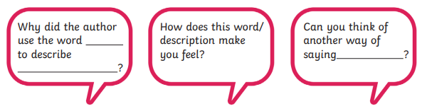
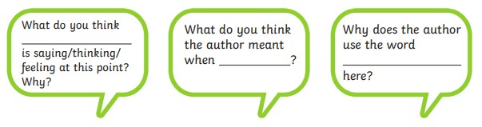
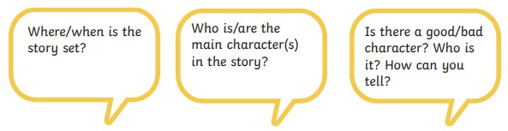
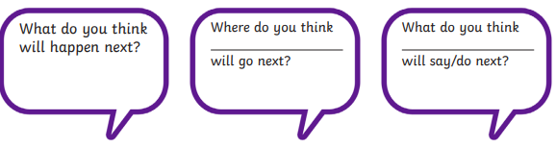
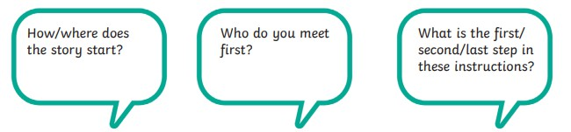
EXAMPLE QUESTIONS THAT BUILD COMPREHENSION SKILLS:

Slide 17
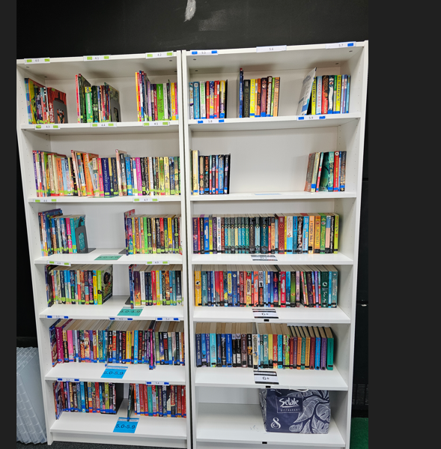
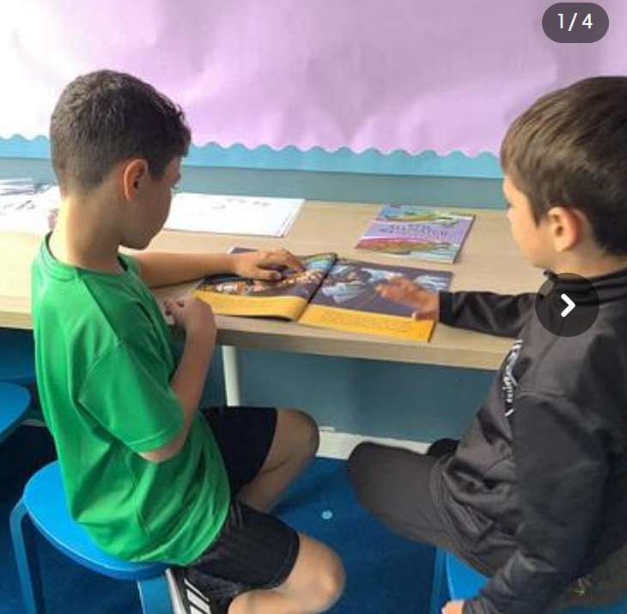
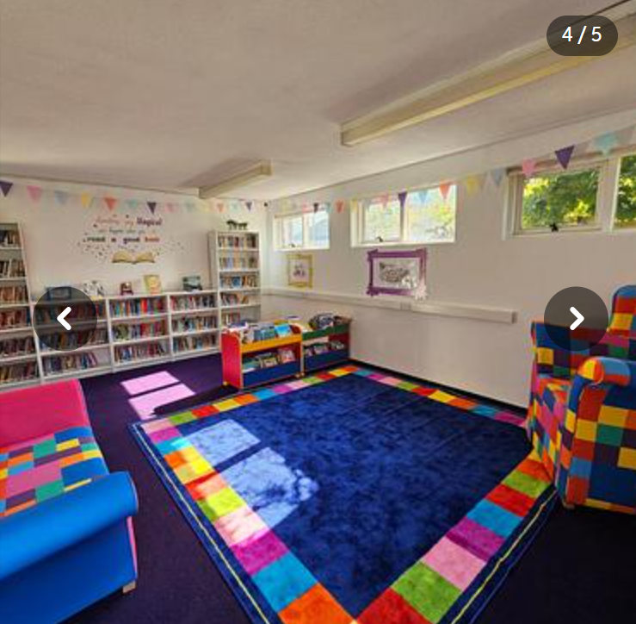
What have we done so far at Waterside?
All children have completed their 1st Star Reader test and have been given their ZPD level and book band.
Children are now beginning to quiz on their books.
Brand new AR books
We have a very exciting new library and children visit weekly

Slide 18
YEAR 2 and YEAR 6 END OF YEAR ASSESSMENTS
In Year 2, children will sit informal assessments where they will be assessed on all
that they have been taught so far. In Year 6 the children will sit compulsory assessments. A key element of this is a reading paper where children must fluently read a text and comprehend its meaning and information.
Children work on these skills of comprehension gradually throughout Year 2, until they are
able to read and comprehend a more substantial piece of text.
In the assessment, children are asked comprehension questions to test their understanding of what they have read and if they can retrieve key information from the text.
In addition to retrieval of information, children are asked to provide their own predictions/inference of what they have read to answer broader style questions.

Slide 19
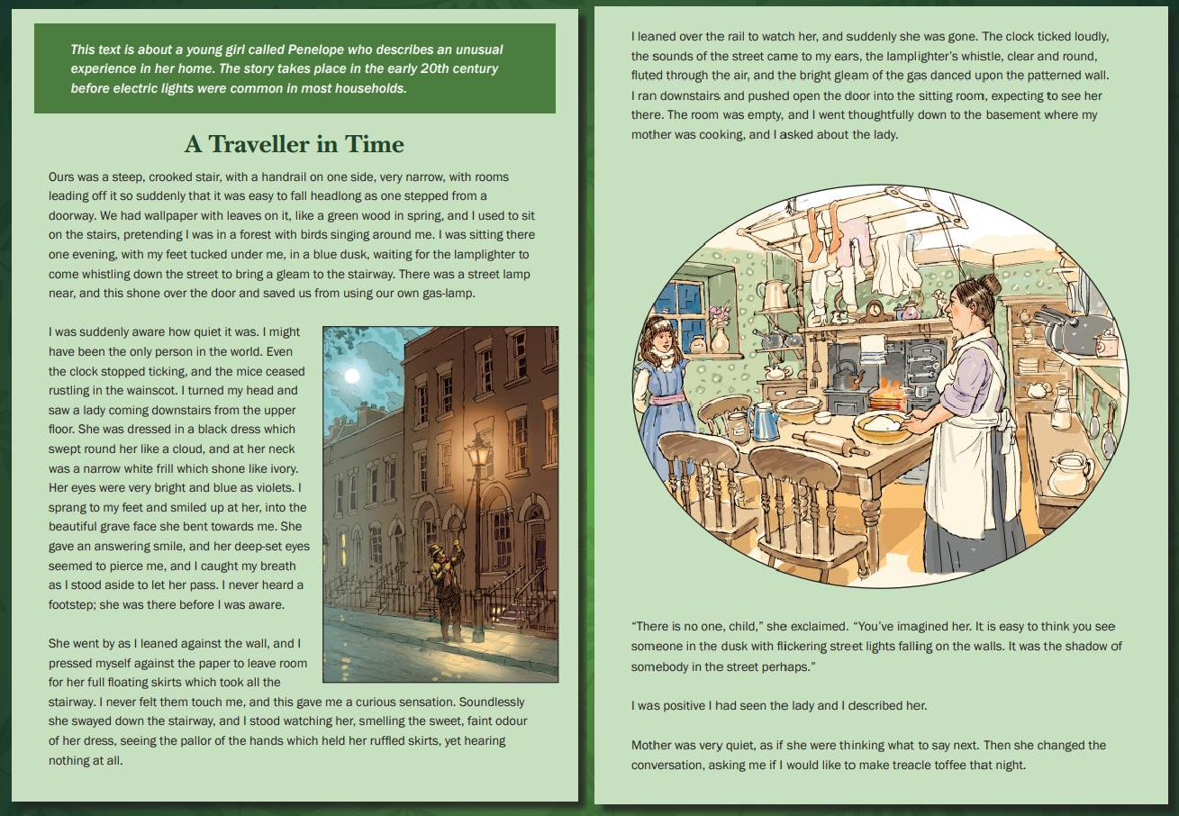
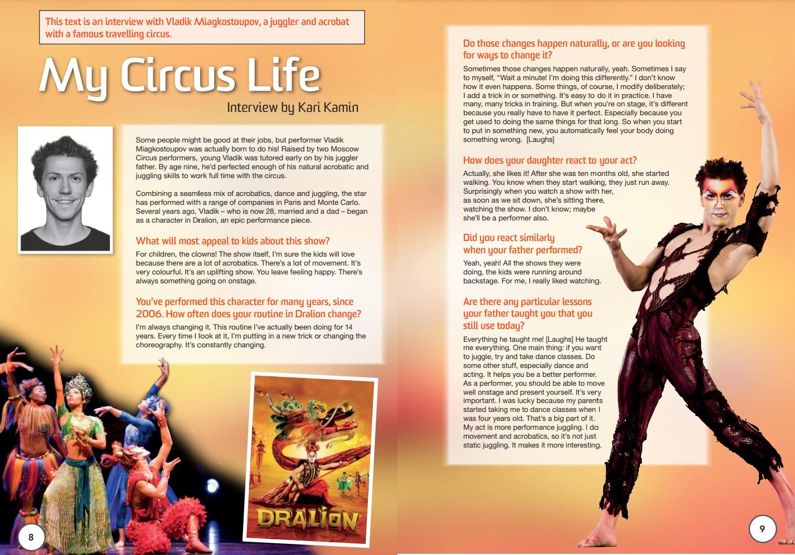
END OF KS2 ASSESSMENTS - SATS

Slide 20
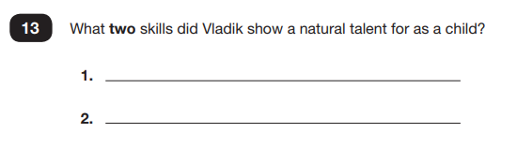
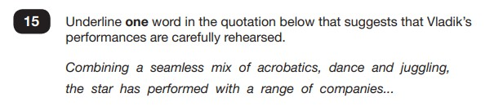
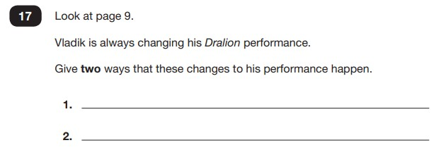
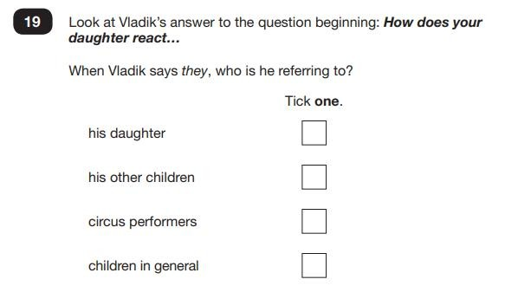
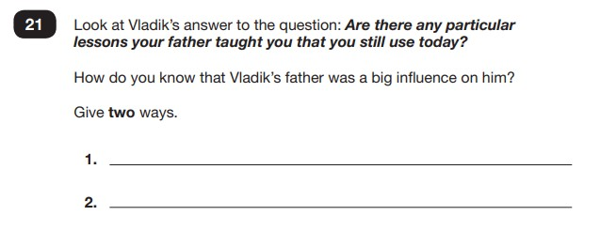

Slide 21
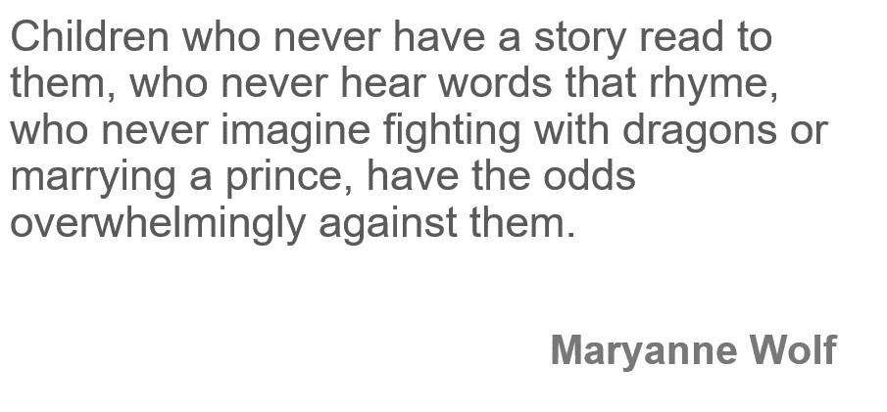
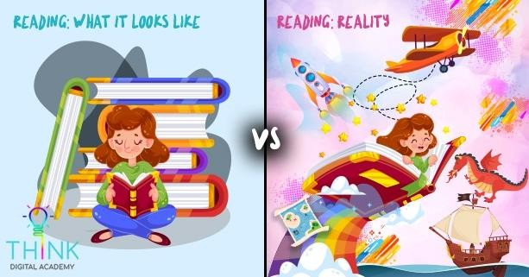
THE IMPORTANCE OF READING

Slide 22
10 THINGS YOUR CHILD LEARNS WHEN YOU READ STORIES AND POEMS OUT LOUD TO THEM:
Sustain attention
Appreciate rhythm and rhyme
Build pictures in their minds from the words on the page
Understand humour and irony
Use new words and phrases in different contexts - and later in writing
Learn new vocabulary and knowledge of the world
Think about characters’ feelings and use appropriate voices
Follow a plot with all its twists and turns
Understand suspense and predict what’s about to happen next
Link sentences and ideas from one passage to the next

Slide 23
TOP TIPS FOR STORYTIMES:
Make it a treat (Find fun and interesting places)
Make it a special quiet time
Show curiosity
Read story once without stopping
Chat about the story
Avoid testing with questions
Link to other stories and experiences
Read favourites over and over again
Use different voices
Love the book

Slide 24




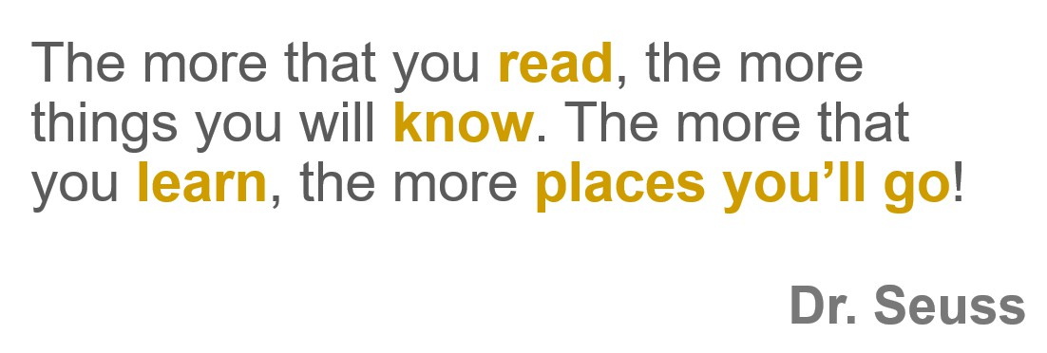
THANK YOU FOR COMING!

