Slide 1


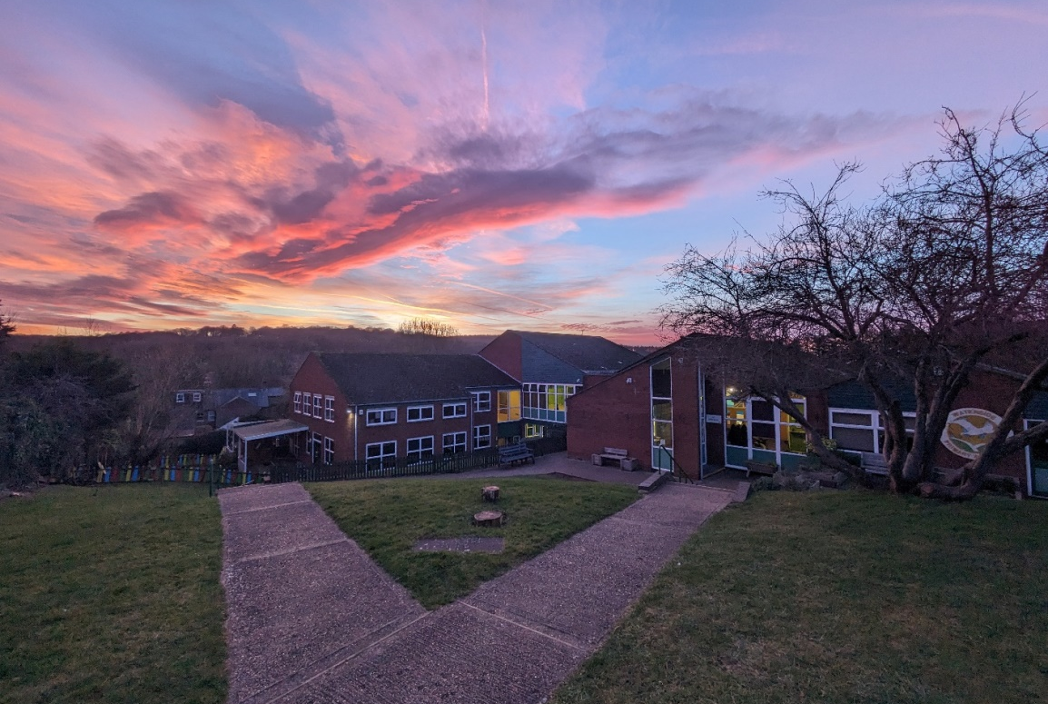

Waterside Primary Academy
Meet the teacher evening
Academic Year 2025 to 2026
#happychildrenlearn
Notes:
NOTE: To change images on this slide, select a picture and delete it. Then click the Insert Picture icon
in the placeholder to insert your own image.

Slide 2
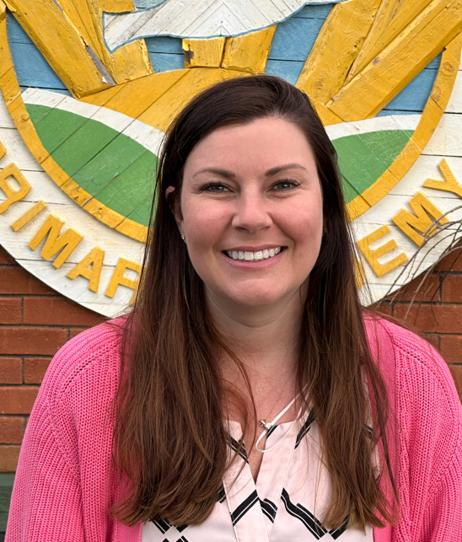
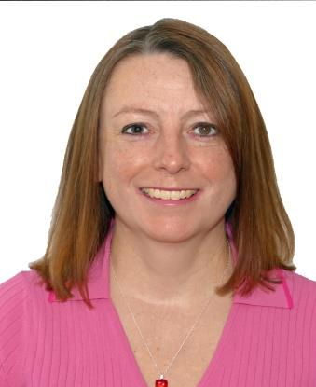

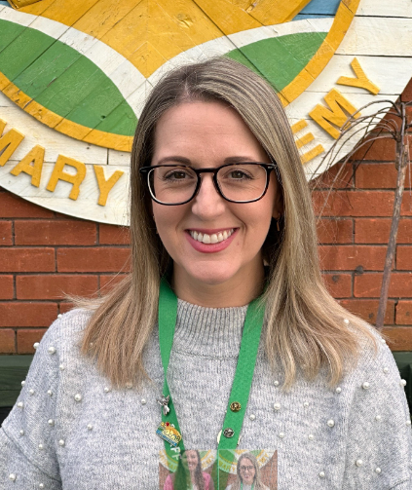
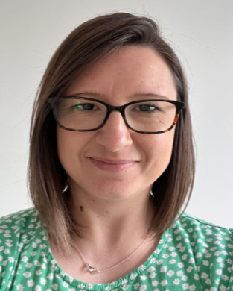
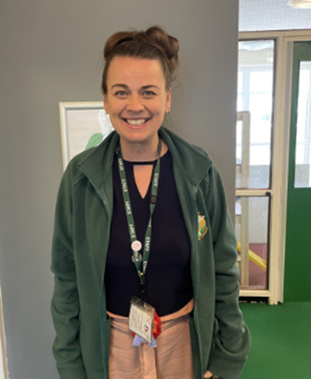
Waterside Primary Academy
Senior Leadership Team
Wider Leadership Team
Mrs Blackmore
Headteacher
Mrs Holland
SENDCo
Ms Trevathan
Co SENDCo
(EYFS and KS1)
Mrs Orchard
Deputy Head
Mrs Scott
Early Years and KS1 Lead
Ms Essex
Family Liaison Officer

Slide 3

Waterside Primary Academy
Safeguarding Team
Mrs Blackmore
Designated
Safeguarding
Lead
Mrs Scott
Deputy
Designated Safeguarding Lead
Look out for our rainbow lanyards
Ms Essex
Deputy
Designated Safeguarding Lead

Slide 4
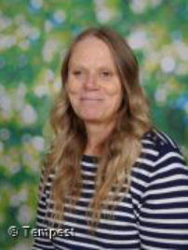
Waterside Primary Academy
Meet the Year 1 teaching team
Mrs Scott
Mrs Odell
Reception Teacher
Early Years and Key Stage 1 Lead
Reception Teaching assistant
Notes:
NOTE: To change images on this slide, select a picture and delete it. Then click the Insert Picture icon
in the placeholder to insert your own image.

Slide 5
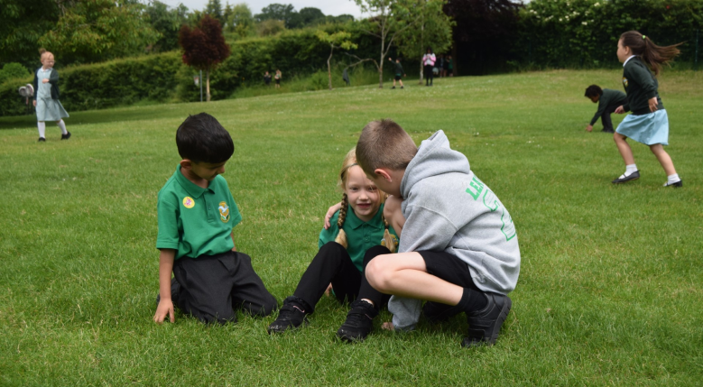






Waterside Primary Academy
Our school values
Notes:
NOTE: To change images on this slide, select a picture and delete it. Then click the Insert Picture icon
in the placeholder to insert your own image.

Slide 6





Waterside Primary Academy
Expectations
Illness absence (call every day)
Report concerns
Seek support
Friendly, caring and helpful
(Card system and Class Dojos)
Good behaviour & manners
(Card system and Class Dojos)
success
Positive attitude to learning
Correct school uniform – Waterside Pride!
Excellent attendance (over 95%)
Punctuality (in school by 8.45am as registers saved at 8.55am).
Pick up is 3.15pm.
Effort in all areas of the curriculum
Completed home learning & in on time
Daily reading at home
(recorded in reading record)

Slide 7
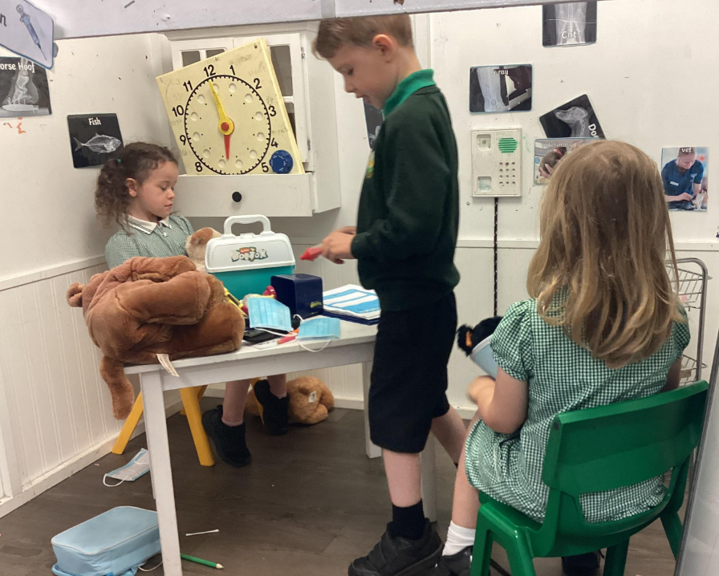
Waterside Primary Academy
The Early Years Foundation Stage (EYFS) sets standards for the learning, development and care of your child from birth to 5 years old.. There are 7 areas of learning and development.
The 3 prime areas:
Communication and language, Physical development,
Personal, social and emotional development
The 4 specific areas:
Literacy, Maths, Understanding the world, Expressive arts and design
Our learning takes place inside and outside.
What is EYFS?

Slide 8
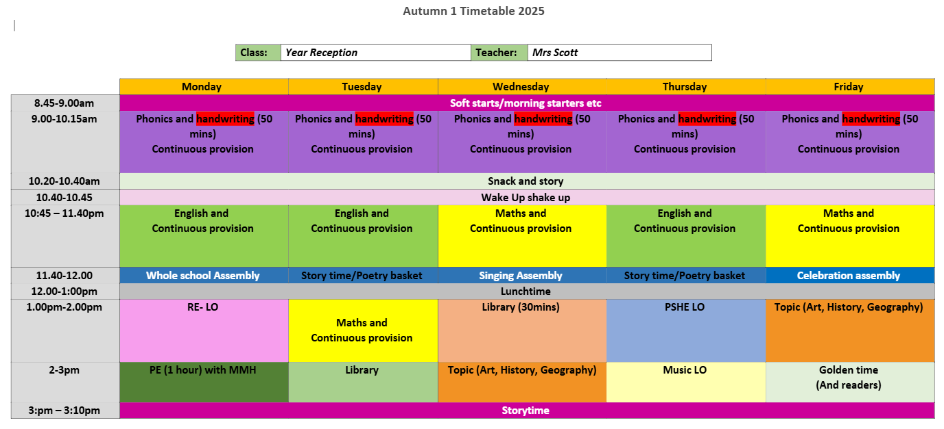
Waterside Primary Academy
Typical Day in Reception

Slide 9



Waterside Primary Academy
Reading
We use the Read Write Inc. phonics scheme
Children are assessed every half term by the Phonics lead
(Mrs Scott) who will then group them accordingly.
Pupils receive a daily phonics session.
You can help at home by reading regularly and filling in their reading record when you have heard them read.
Notes:
NOTE: To change images on this slide, select a picture and delete it. Then click the Insert Picture icon
in the placeholder to insert your own image.

Slide 10
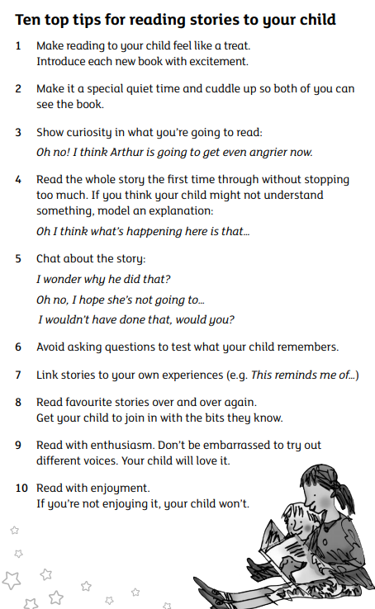
Reading
Notes:
NOTE: To change images on this slide, select a picture and delete it. Then click the Insert Picture icon
in the placeholder to insert your own image.

Slide 11

Waterside Primary Academy
Writing overview
Notes:
NOTE: To change images on this slide, select a picture and delete it. Then click the Insert Picture icon
in the placeholder to insert your own image.

Slide 12
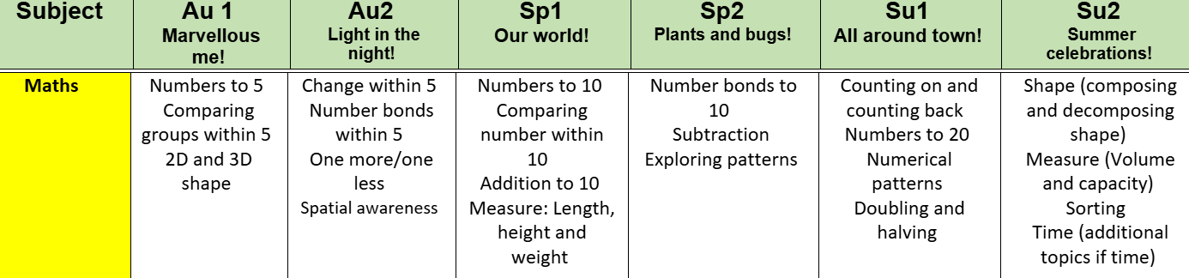
Waterside Primary Academy
Maths overview
Notes:
NOTE: To change images on this slide, select a picture and delete it. Then click the Insert Picture icon
in the placeholder to insert your own image.

Slide 13

Waterside Primary Academy
Equipment needed
Notes:
NOTE: To change images on this slide, select a picture and delete it. Then click the Insert Picture icon
in the placeholder to insert your own image.

Slide 14
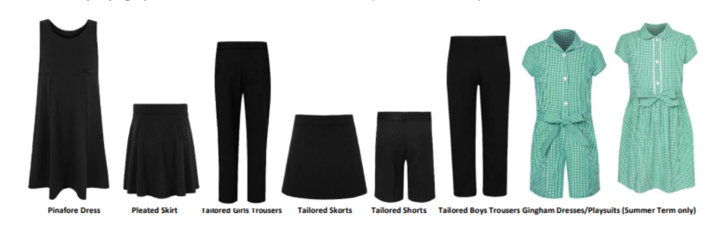


Waterside Primary Academy
School Uniform
Waterside jumper or cardigan and polo top
Summer dress or culottes dress
Book bag
Tailored black trousers, skirt, pinafore or shorts
Notes:
NOTE: To change images on this slide, select a picture and delete it. Then click the Insert Picture icon
in the placeholder to insert your own image.

Slide 15
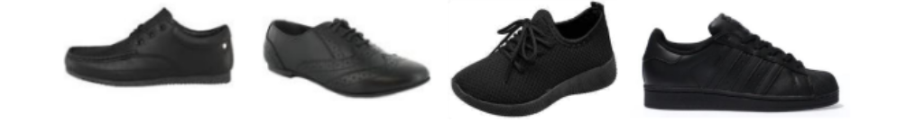

Waterside Primary Academy
Footwear reminders
Your child will need to wear black trainers on PE days.
Notes:
NOTE: To change images on this slide, select a picture and delete it. Then click the Insert Picture icon
in the placeholder to insert your own image.

Slide 16

Waterside Primary Academy
PE kit
Waterside hat
Waterside PE t-shirt, waterproof coat and fleece
Black shorts, skort or joggers
Waterside leggings and top
Notes:
NOTE: To change images on this slide, select a picture and delete it. Then click the Insert Picture icon
in the placeholder to insert your own image.

Slide 17







Waterside Primary Academy
Every child must have a Parent Pay account, regardless of eligibility, as this is the only way that meals can be ordered in future.
If you need to open a Parent Pay account please contact the school office to obtain an activation letter to access the website and order online.
Access your Parent Pay account by clicking here
Meal bookings MUST BE placed in advance by each Thursday for the following week.
You will see the menus on Parent Pay and on the school website.
Children in Reception and Years 1 & 2 are entitled to a free school meal each day but this must be ordered this on Parent Pay.
Children in Years, 3, 4, 5 & 6 - Any child who is eligible for Free School meals must also have a Parent Pay account to order meals online.
If you do not wish your child to have a school meal, please provide a packed lunch.
Please ensure that your account is kept in credit at all times.
Our hot meals are provided by Culinera caterers.
Every child must have a Parent Pay account, regardless of eligibility, as this is the only way that meals can be ordered in future. If you need to open a Parent Pay account please contact the school office to obtain an activation letter to access the website and order online.
Meal bookings need to be placed in advance by each Thursday for the whole of the following week to give our catering team time to prepare. You will see the menus on Parent Pay and on this website.
Children in Years, 3, 4, 5 & 6 - Any child who is eligible for Free School meals must also have a Parent Pay account to order meals online.
Please ensure that your account is kept in credit at all times.
Our hot meals are provided by Culinera caterers.
Parent Pay
Please access your Parent Pay account by clicking here

Slide 18

Waterside Primary Academy
Supporting your child at home
All children should read 5 times a week and this should be recorded in your child’s Reading Record (in EYFS state that all children should listen to a story each night and record in reading record, until they start getting a Ditty sheet or RWI book)
RWI –The children will receive two RWI books per week.
Parent video: How to say the sounds – YouTube
Key Facts:
Talk to your children as much as possible and encourage conversations to develop language & read to your child and listen to them read as much as possible as research shows that children perform better and make more progress when parents focus on reading and vocabulary!

Slide 19


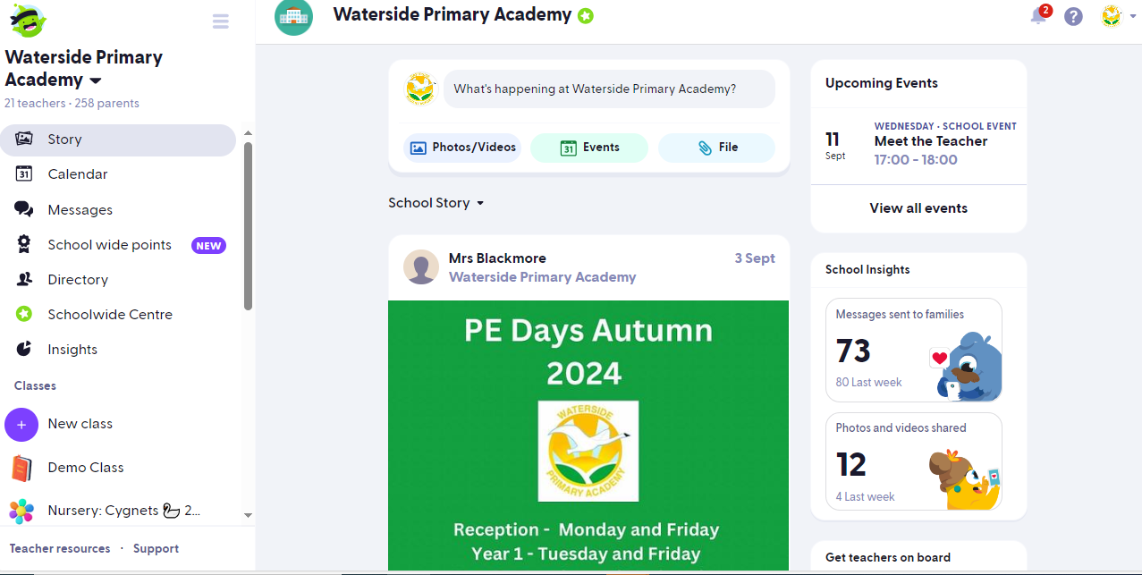
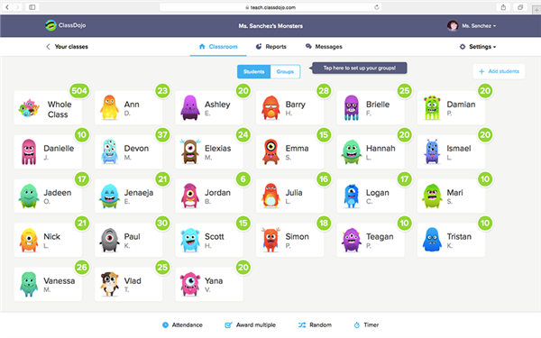
Waterside Primary Academy
Notes:
NOTE: To change images on this slide, select a picture and delete it. Then click the Insert Picture icon
in the placeholder to insert your own image.

Slide 20
Restorative approach within school
Waterside Primary Academy
At Waterside PA, we try to use a positive approach in helping our children to feel good about themselves.
We have a ‘Celebration assembly’ every Friday where a child is chosen to be ‘Star of the week’.
We also award children with subject and caring awards at the end of each half term/term.
We encourage the children to become problem solvers by using a restorative approach of teaching them how to resolve issues between themselves.
We avoid heavy behaviour sanctions as much as possible but instead use a nurturing and responsive approach to help our children learn how to manage their feelings and behaviours.

Slide 21
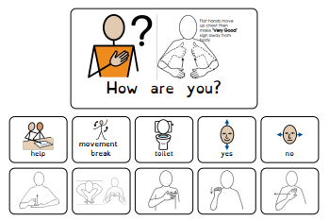
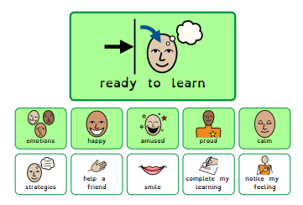
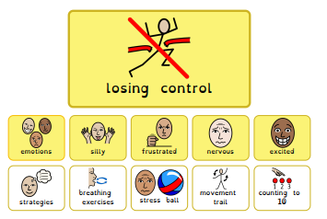
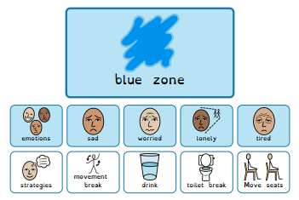
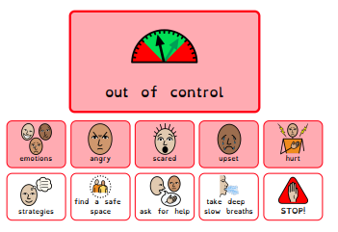
Restorative approach within school
Waterside Primary Academy
The children use a daily feelings chart (Zones of regulation) and can share how they feel with the rest of the class daily.
This helps children understand their own feelings and be able to express themselves from a young age, encouraging them to be much more emotionally intelligent and aware of others.
Please read more about our visions and values and behaviour policy on
our website.

Slide 22
Waterside Primary Academy
Wraparound
Breakfast Bunch Club
This club is run by our Waterside Team members (Miss Bell, Miss Cyster and Mr McHugh). Breakfast Club is held in the Dining Room until 8:45 when the children will be sent to class to start the school day.
This club costs £3 per session with a nutritious breakfast provided. £2 for each additional sibling. Children who are in receipt of Pupil Premium can access this club for free.

Slide 23
Waterside Primary Academy
Wraparound
Premier Education
Premier Education are providing after school care every day the school is open - we will also have a variety of sports clubs to choose from each afternoon. These activities will vary between year groups and topics will change every half term. Our aim is to deliver a top quality, Ofsted-registered provision, with a range of stimulating activities in a safe, secure, and fun environment, providing an outstanding service for busy parents.

Slide 24
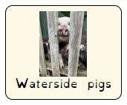

Waterside Primary Academy
PTA and The Waterside Pigs
You can join the Parent and Teacher Association and be involved with wide school events such as the Christmas and summer fayre and the carnival.
Please speak to the office in September if you’d like to join in the fun!
You and your child can become involved with helping look after our pigs.
In September, there will be more information from Mrs Read of how you can get involved!

Slide 25

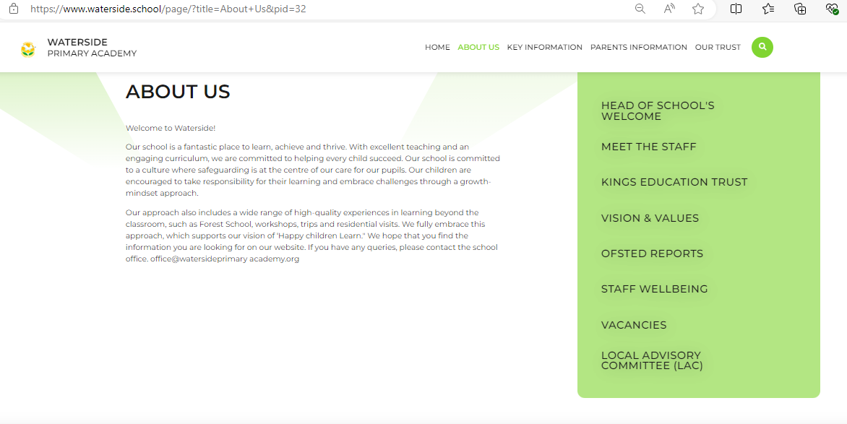
Waterside Primary Academy
Our website
Waterside Primary Academy - About Us

