Slide 1
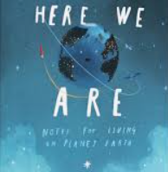
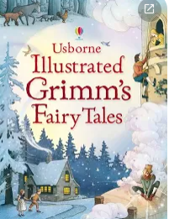










Spring term 2: Year 2
English Here we are (Oliver Jeffers) | Reading Grimm’s fairy tales | Maths Money, multiplication and division | PSHE Healthy me
Geography/History How did we learn to fly? | Art/DT Baby bear’s chair (structures) | Music Zootime (reagge) | RE Easter –resurrection
Science Animals including humans | Computing Data and info – pictograms | PE Dance | Upcoming trips Mosque visit Orchestra concert at school

