Slide 1
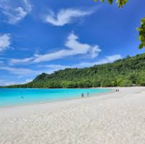
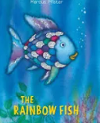
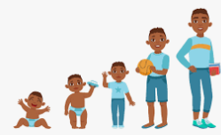

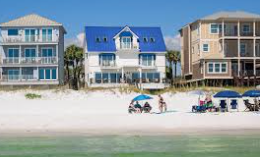
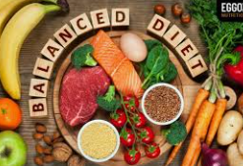

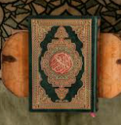

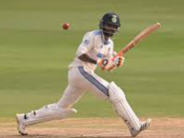
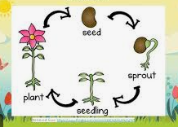
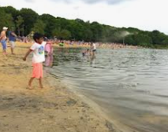
Summer term 2: Year 2
English The beach song (poetry) | Reading The rainbow fish | Maths Statistics Fractions Position and direction Time | PSHE Changing me
Geography/History What is like living by the coast? | Art/DT A balanced diet | Music Reflect, rewind and replay | RE Islam - How important is the Qur’an to Muslims?
Science Life cycles – plants | Computing Programming quizzes | PE Cricket | Upcoming trips Ruislip Lido

